Slide 1
CARBON COMPOUNDS
INTRODUCTION

Slide 2
CARBON AND ITS COMPOUNDS
The range of chemicals studied in organic chemistry include hydrocarbons (compounds containing only carbon and hydrogen), as well as compounds of carbon containing other elements, especially oxygen, nitrogen, sulfur, phosphorus (included in many bio chemicals) and radio stable elements of the halogens.

Slide 4
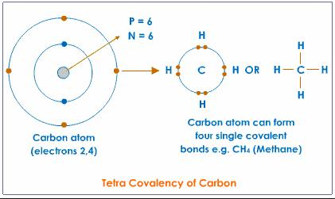
Carbon atoms are tetravalent. This means that they have to either lose or gain four electrons to acquire a stability. ... Now, as cations or anions are formed due to gaining or losing of electrons(or the formation of ionic bonds),carbon does not form ions(as it forms covalent bonds).

Slide 5
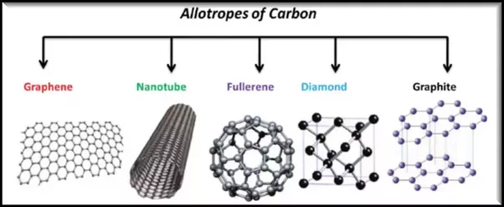

Slide 6
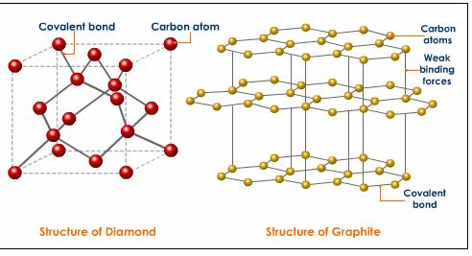
CRYSTALLINE STRUCTURE OF CARBON

Slide 7
